Slide 1
2rd Grade
Computer Science Dept/ College of Education for Pure Sciences
Special Topics: Microprocessor & Assembly Language
Lecture 7
Instructor: Ghazwan Abdulnabi Al-Ali
University of Basrah, Iraq

Slide 2
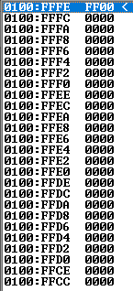
The stack
Stack is a segment of memory , it is 64kb in length and organized from software point view as 32kb words.
During the subroutines call the contents of certain registers of 8088 are pushed to the stack, they are saved temporarily.
At the completion of the subroutine these values are popped off the stack and put back into the same registers where they originally reside.
When a call instruction is executed the 8088 automatically pushed the current values in CS and IP into the Stack.
As indicated before the register (SS) holds the address of the stack segment and (SP) contains the Offset address.
The address obtained from combining SS value with SP value is the physical address of the last storage location in the stack, this location is known as Top of stack (TOS).

Slide 3
PUSH & POP. Reg
PUSH.reg: When push - instruction is applied to a register the following will occur:
  SP value is automatically decremented by 2 (SP=SP-2)
  The contents of Reg is saved_ in the stack at the address referred by SP.
POP.Reg: When pop instruction is applied to a register the following will occur:
  The contents are popped from the stack and put back to it's register.
  SP value is automatically incremented by 2 (SP= SP +2).

Slide 4
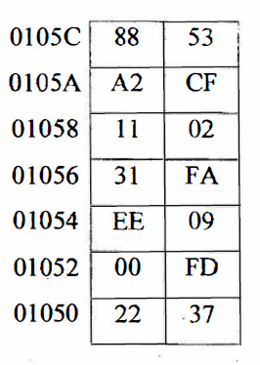
Example
suppose the following Stack segment :-
  And let SS = 01050 , SP= 0008 and AX=3A3C show what happen if we execute the instruction PUSH AX ?
  solution
  0 1 0 5 0
  0 0 0 8
  __________
  0 1 0 5 8 this is the value of (TOS)

Slide 5
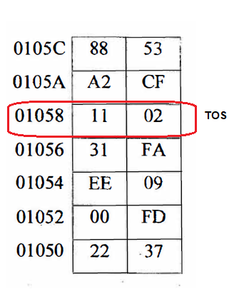
Example Cont.
suppose the following Stack segment :-
  And let SS = 01050 , SP= 0008 and AX=3A3C show what happen if we execute the instruction PUSH AX ?
  solution
  0 1 0 5 0
  0 0 0 8
  __________
  0 1 0 5 8 this is the value of (TOS)

Slide 6
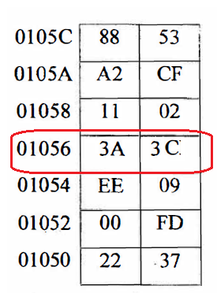
Example Cont.
  MOV AX, 3A3C
  PUSH AX
As indicted when push instruction applied to AX
SP=SP-2 =TOS, 01058-2=01056.

Slide 7
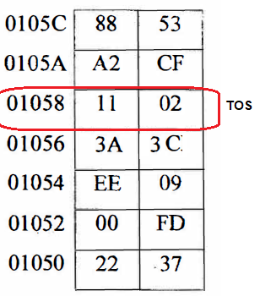
Example POP.
  POP AX
As indicted when POP instruction applied to AX
SP=SP+2 =TOS, 01056+2=01058 , AX= 3A3C.

Slide 8

Flag register
STATUS Register(Flag register)
  It is a 16 bit in length ,only nine of its bit are implemented , six of them are called status flags(they are automatically set after execution of arithmetic operation)
  CF (Carry Flag):
  is set(1) if there are a carry out or borrow in for the most significant bit during the execution of an arithmetic operation, other wise CF is reset (0).
  PF(Parity Flag):-
    It is set if the number of 1 s in the result ( of an arithmetic operation) is even other wise , it is set.

Slide 9
Flag register Cont.
  AF(Auxiliary Carry Flag):-
    It is set if there is a carry out from the low nibble to high nibble or borrow in from high nibble to low nibble, other wise it is reset.
  ZF (Zero Flag):-
  It is set if the result of an arithmetic operation is zero, else it is reset.
  SF (Sign Flag):-
  it is set if the result is negative and it is reset if the result is positive.
  the (MSB) (most significant bit) is copied into (SF), if I the result is negative , if zero it is positive.
  OF(Overflow Flag):-
is set, it indicates that the signed result is out of range, if the result if not out of range is reset.

Slide 10
Control Flags
The three other flags are called Control Flags:
  TF (Trap Flag) :-
    if (TF) is set(1) that make 8088 goes in single-step mode(it executes one instruction at a time).
  IF (Interrupt Flag):-
    to recognize interrupt request IF should be set (1) , if IF is reset the Interrupt request will be ignored.
  DF (Direction Flag):-
    it determines the direction in which string operation will occur, if DF. is set the string instruction automatically decrements the address(from high address to low address), if DF is reset causes the string address to be incremented (from low address to high address).

Slide 11
Ex.
Write an assembly language program to generate B where b is the inverse of A.(Use a stack)

Slide 12
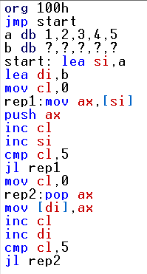
Solution:

Slide 13
Thank You

